Slide 1
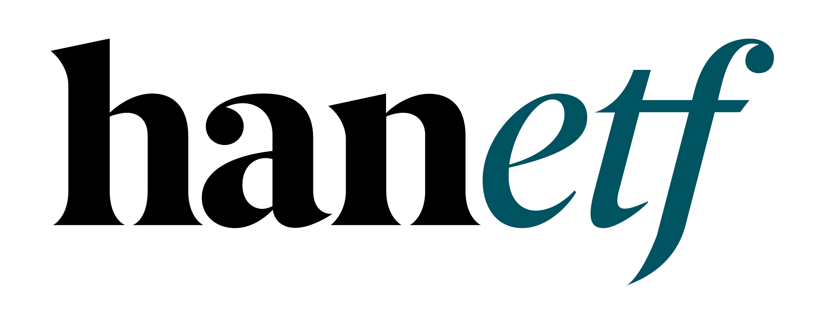

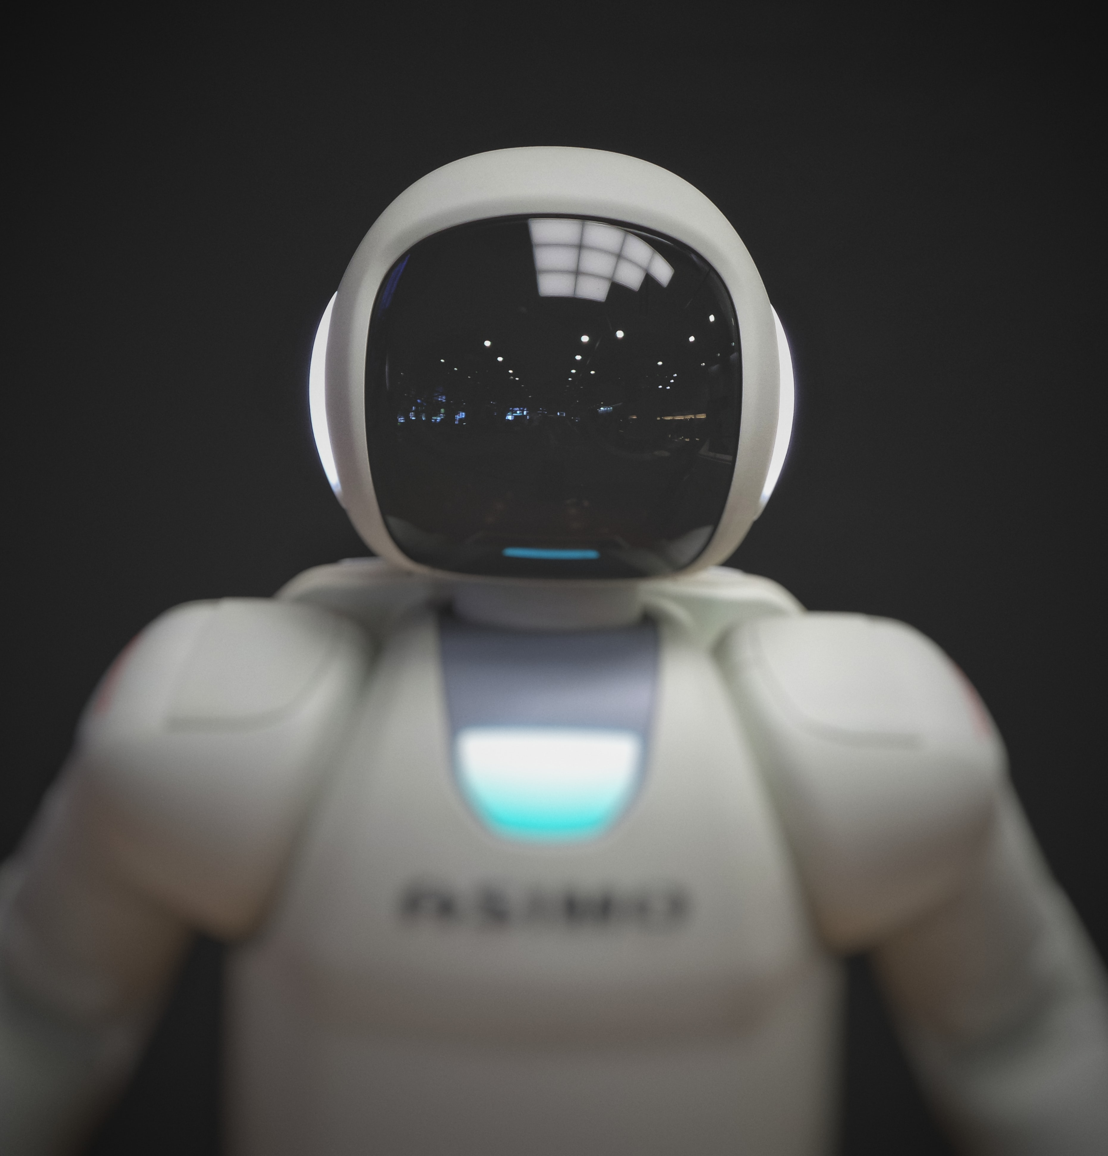
Tech Megatrends
HAN-GINS Tech Megatrend ETF
For professional clients only. Capital at risk
The content of this document does not constitute investment advice nor an offer for sale nor a solicitation to buy any product or make an investment.

Slide 2










Industrial Revolution 4.0
Tech Megatrends (140 stocks)
Future Transport
Digital Entertainment
Social Media
Cyber Security
MEGATRENDS
10 Themes
AI & Robotics
Quantum Computing
Defence Technology
Cloud Computing
Blockchain
Genomics
www.HANetf.com
info@hanetf.com

Slide 3
Tech Megatrends - gains

Slide 4
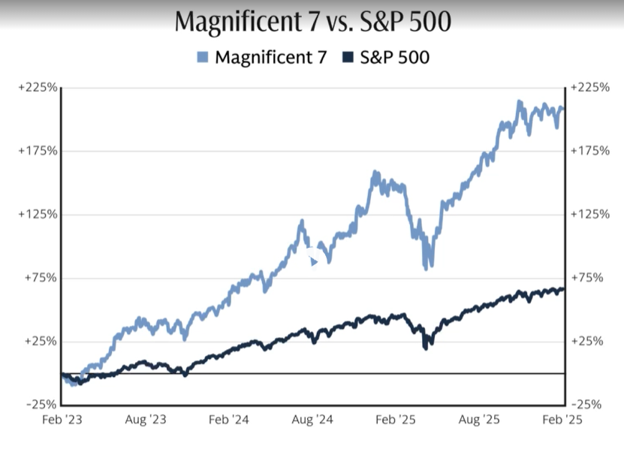
Big Tech Performance vs S&P (3yr)

Slide 5
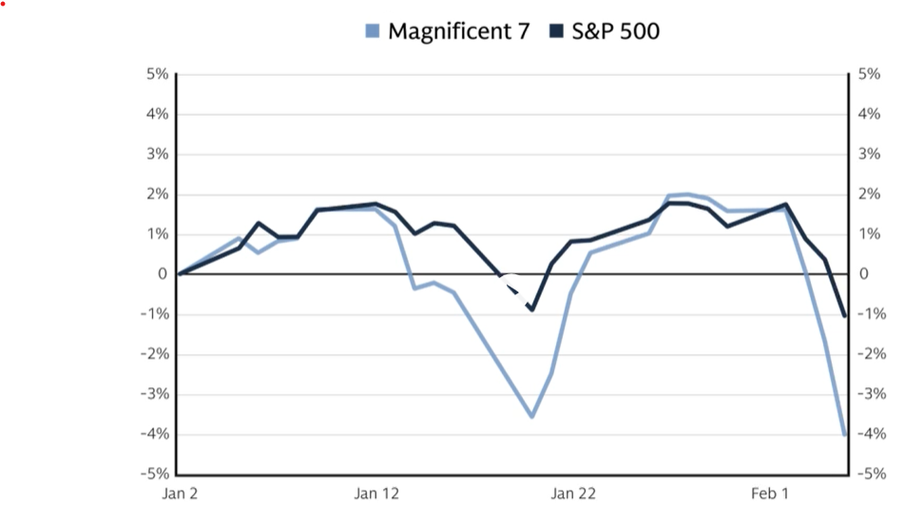
Latest Big Tech Performance (2026)

Slide 6
Diversified Tech Investing
Global Mix – reduces volatility.
Broad Index approach.
140 Equal Weight Holdings
Tailwinds – lower interest rates, Tech convergion
Strong financials = not 2000 Bubble.

Slide 7
US Resilient: Soft-Landing
Low Unemployment & Interest Rates.
Healthy US GDP growth of 3%+.
Inflation <3%.
Positive Earnings 14% S&P EPS gains (2026).
Less red-tape; Lower Taxes

Slide 8
TER | 49 bps
Future of Defence UCITS ETF
NATO
Positive Tech Outlook
Tech M&A activity rebounding.
Outsourcing - AI, Cloud & Cybersecurity.
Robotics – Onshoring/Tariff benefits.
Fed rate cuts = positive Tailwind.
Weaker US$ - boosts US Tech earnings.

Slide 9
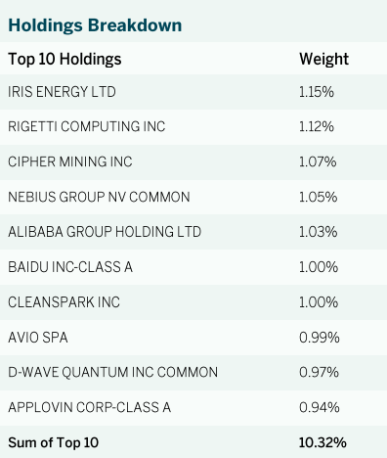
MEGATREND FUND – Weights
Mag7 Holdings | Nasdaq Weight | Fund Weight
MICROSOFT CORP | 8.8% | 0.9%
APPLE INC | 7.4% | 0.8%
NVIDIA CORP | 6.3% | 0.9%
AMAZON.COM INC | 5.3% | 0.0%
META PLATFORMS INC | 4.8% | 0.9%
ALPHABET INC-CL A | 2.5% | 1.0%
ALPHABET INC C-SHARES | 2.4% | 0.0%
TESLA INC | 2.4% | 0.7%
TOTAL | 39.9% | 5.2%
Data as of 30/07/2025.
Data as of 30/09/2025.

Slide 10
Megatrend Index: 10 subthemes
Category | Fund Contribution | No. of Holdings
AI & Robotics | 1.7% | 15
Blockchain | 6.0% | 15
Cloud Computing | 2.6% | 15
Cyber Security | 2.7% | 15
Defense Technology | 0.4% | 15
Digital Entertainment | 2.8% | 15
Future Cars | 2.0% | 15
Genomics | 1.9% | 15
Quantum Computing | -1.6% | 5
Social Media | 0.8% | 15
Sum | 19.1%

Slide 11
TER | 49 bps
Future of Defence UCITS ETF
NATO
TER | 59 bps
HAN-GINS Tech Megatrend Equal Weight UCITS ETF
ITEK
Diversification power
TECH MEGATRENDS
Rank | 2017 | 2018 | 2019 | 2020 | 2021 | 2022 | 2023 | 2024 | 2020-2024 | 3Y Avg Sharp
1 | Robotics 2 | Cloud & Digital 2 | Digital Entertainment 2 | Blockchain 2 | Blockchain 1 | Health & Biotech 2 | Blockchain 1 | Digital Entertainment 1 | Digital Entertainment 2 | 1.20 | Digital Entertainment 2
2 | Robotics 1 | Cyber Security 1 | Robotics 1 | Cars & Battery 1 | Digital Entertainment 1 | Cars & Battery 2 | Digital Entertainment 2 | Digital Entertainment 2 | Cyber Security 2 | 1.09 | Blockchain 1
3 | Digital Entertainment 2 | Cloud & Digital 1 | Blockchain 2 | Cars & Battery 2 | Robotics 1 | Cyber Security 2 | Robotics 1 | Cloud & Digital 1 | Cars & Battery 2 | 1.07 | Digital Entertainment 1
4 | Health & Biotech 1 | Cyber Security 2 | Robotics 2 | Cloud & Digital 2 | Cyber Security 2 | Health & Biotech 1 | Blockchain 2 | Cyber Security 2 | Blockchain 2 | 0.94 | Cloud & Digital 1
5 | Cars & Battery 2 | Health & Biotech 1 | Cyber Security 1 | Digital Entertainment 2 | Robotics 2 | Cloud & Digital 2 | Cyber Security 2 | Cyber Security 1 | Cloud & Digital 1 | 0.84 | Cyber Security 2
6 | Cloud & Digital 2 | Health & Biotech 2 | Cyber Security 2 | Health & Biotech 1 | Cars & Battery 2 | Cyber Security 1 | Cloud & Digital 1 | Blockchain 1 | Cyber Security 1 | 0.67 | Cyber Security 1
7 | Health & Biotech 2 | Digital Entertainment 2 | Cloud & Digital 2 | Robotics 2 | Blockchain 2 | Cloud & Digital 1 | Cyber Security 1 | Blockchain 2 | Robotics 1 | 0.52 | Robotics 1
8 | Cyber Security 1 | Robotics 1 | Cloud & Digital 1 | Cloud & Digital 1 | Cars & Battery 1 | Blockchain 1 | Digital Entertainment 1 | Cloud & Digital 2 | Robotics 2 | 0.41 | Blockchain 2
9 | Cyber Security 2 | Robotics 2 | Cars & Battery 2 | Cyber Security 2 | Cyber Security 1 | Digital Entertainment 1 | Robotics 2 | Robotics 1 | Cars & Battery 1 | 0.25 | Cloud & Digital 2
10 |  | Blockchain 2 | Health & Biotech 1 | Robotics 1 | Cloud & Digital 1 | Robotics 1 | Cloud & Digital 2 | Health & Biotech 1 | Cloud & Digital 2 | 0.09 | Robotics 2
11 |  | Cars & Battery 2 | Health & Biotech 2 | Cyber Security 1 | Digital Entertainment 2 | Digital Entertainment 2 | Cars & Battery 2 | Robotics 2 | Health & Biotech 1 | -0.06 | Cars & Battery 2
12 |  |  |  | Health & Biotech 2 | Cloud & Digital 2 | Robotics 2 | Health & Biotech 1 | Cars & Battery 2 | Health & Biotech 2 | -0.21 | Health & Biotech 1
13 |  |  |  |  | Health & Biotech 2 | Cars & Battery 1 | Cars & Battery 1 | Health & Biotech 2 |  | -0.47 | Health & Biotech 2
14 |  |  |  |  | Health & Biotech 1 | Blockchain 2 | Health & Biotech 2 | Cars & Battery 1 |  | -0.75 | Cars & Battery 1
*Sorted by Sharpe Ratio. Source: Bloomberg, data as of Feb 2025. For illustrative purposes only.
www.HANetf.com
info@hanetf.com

Slide 12
Global Tech Mix – 140 stocks
USA 56%, China 12%, Japan 8%, Israel 3.5%, Germany 3%.
Best 2025 Themes:
    Blockchain 32%
    AI-Robotics 15%
    Cybersecurity 14%
    Cloud 10%
    Defense Tech & Genomics 9%
    Digital Entertainment 8.5%
    Social Media 7%

Slide 13
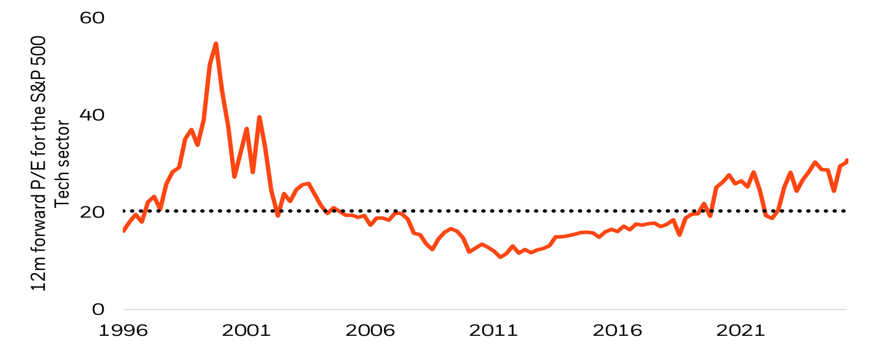
US Tech: P/E ratio – S&P 500 IT Index

Slide 14
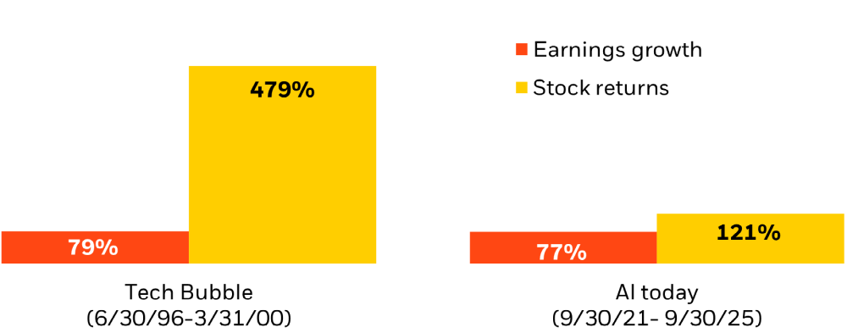
US Tech Earnings: Comparison
Source: Refinitiv from 6/30/1996 to 3/31/2000, and AI today 9/30/2021 to 9/30/2025 (right). Price represented by the S&P 500 Information Technology Index, and Earnings represented by the I/B/E/S S&P 500 Information

Slide 15
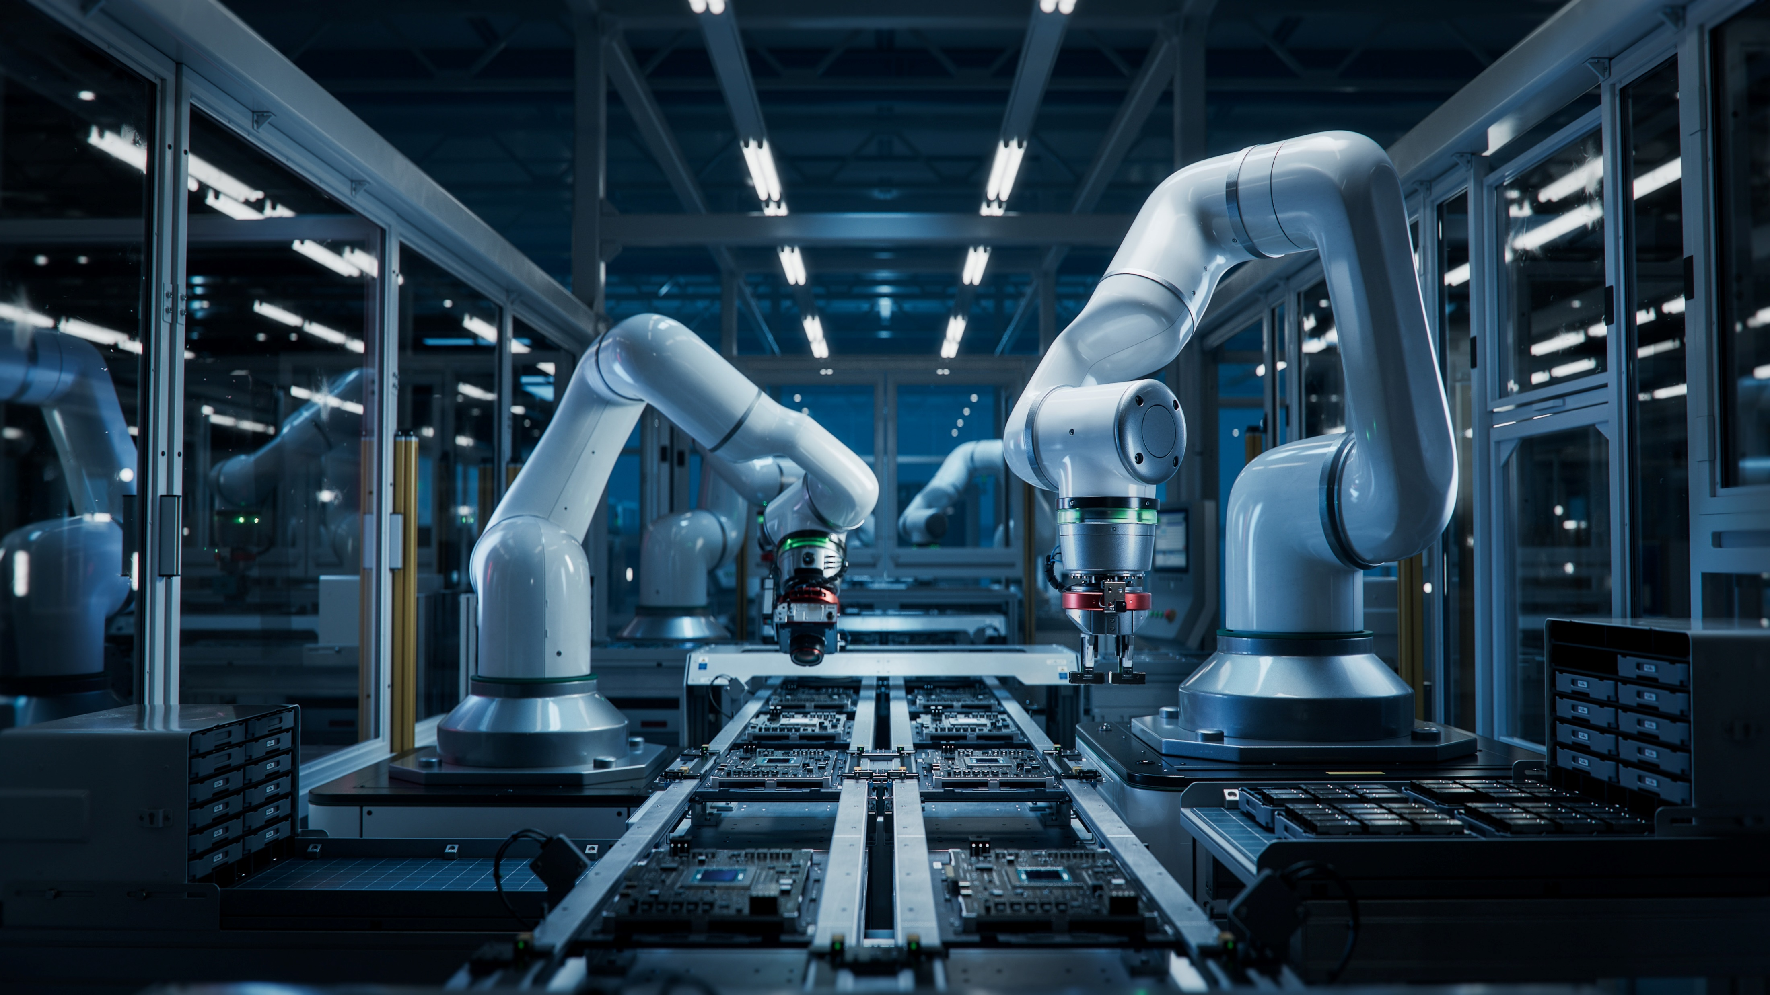
Tech Megatrend – Valuations
Nasdaq P/E 32X vs Megatrends 20X
  P/Book 7.1 vs 2.9.
  P/Sales 5.1 vs 2.6.
MegaCap weight: 58% Nasdaq vs 9%.
Top 10 Holdings: 49% Nasdaq vs 10%.
Top 5 Holdings: 35% Nasdaq vs 6%.

Slide 16

Tech Megatrends Outlook
Converging - AI, Cloud, SM, Gaming, Quantum.
AI $3tn spend in 5yrs.
Strong B/Sheets - Not 1999.
Onshoring Tailwinds.

Slide 17
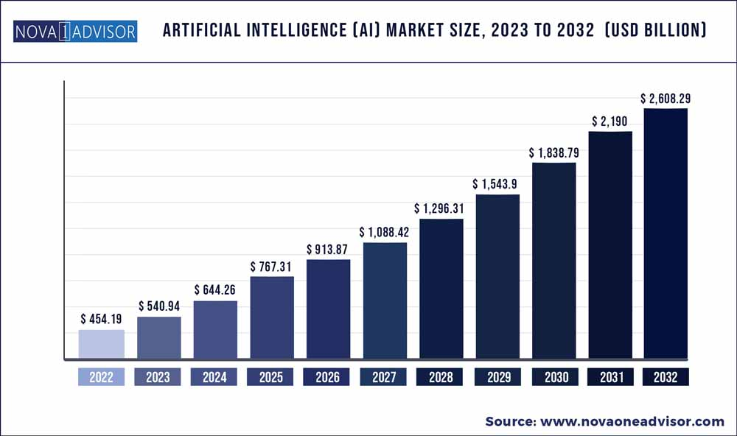
AI Market Forecast
Notes:
Additional reading: savvyreport_nyli_june2024_ver3_final2.pdf (savvyinvestor.net)

Slide 18
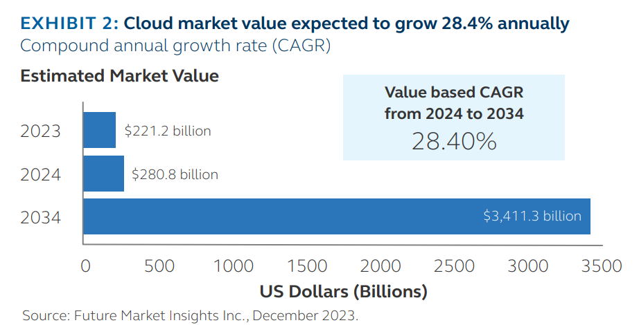
Cloud Market Growth
Notes:
10 trends driving the global data center market (irei.com)

Slide 19
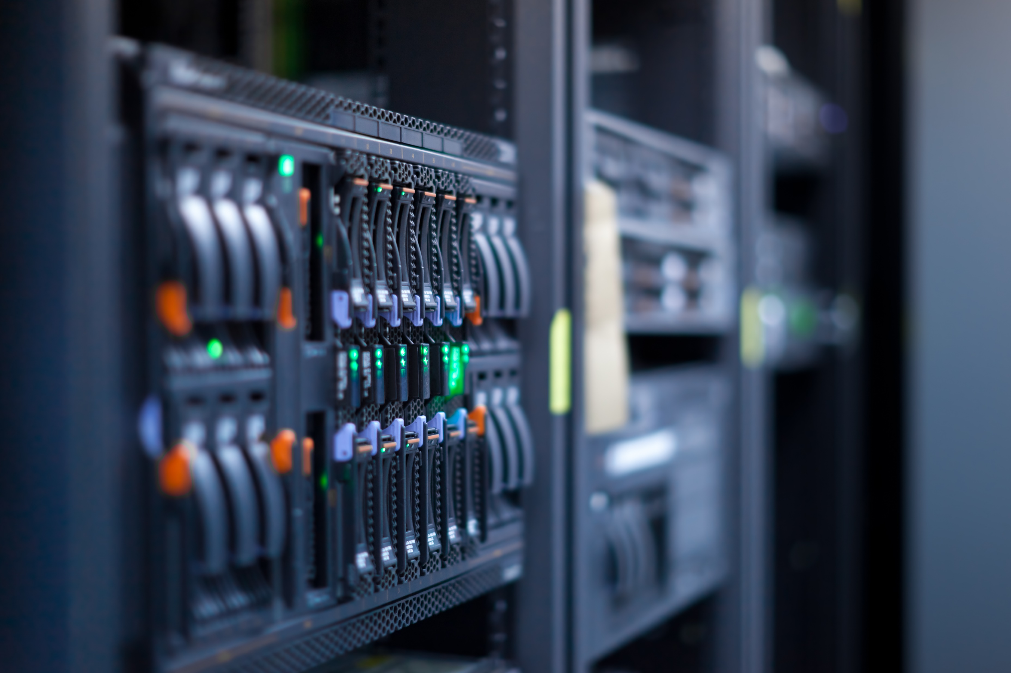
AI & Cloud Booming
AI boosts Cloud spend.
Cloud = 50% of Corporate IT spend by 2026.
Cloud < 25% corporate workloads.
28%+ CAGR.
WFH/Hybrid → Cloud cost savings.

Slide 20
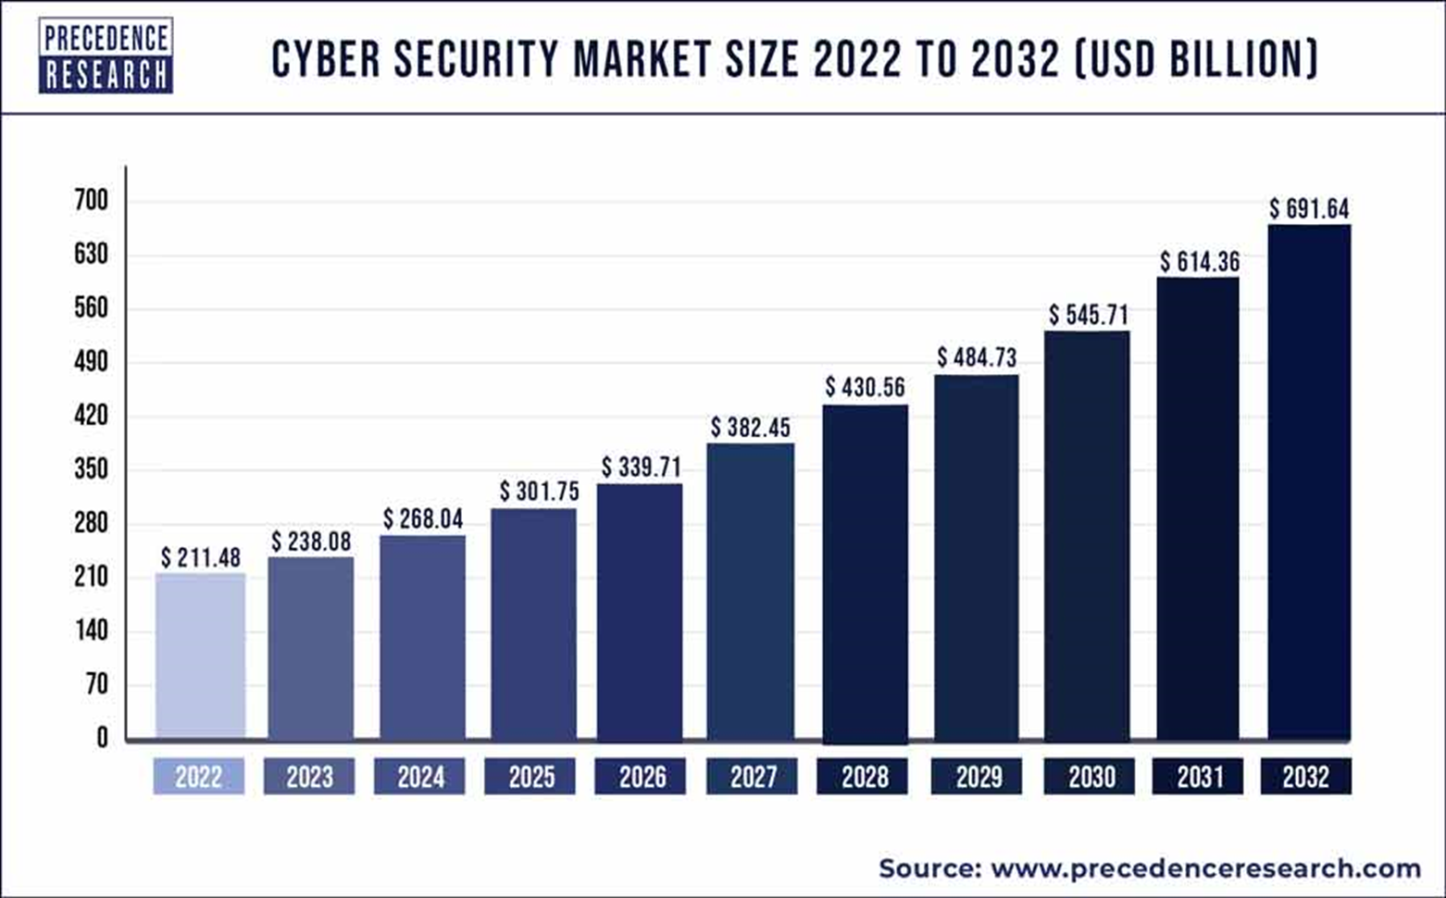
Cybersecurity to Double

Slide 21
Quantum – surging investments
Tech Breakthroughs accelerating.
  Milestones (Google’s Willow & IBM).
  IonQ’s scaling toward millions of qubits.
Govts committed >$42bn – Viable commercial uses.
Cloud-based quantum platforms - strategic partnerships
Revolutionary leap in computational power.
Key sectors - Pharma, AI, Finance, Materials Science, Logistics.

Slide 22
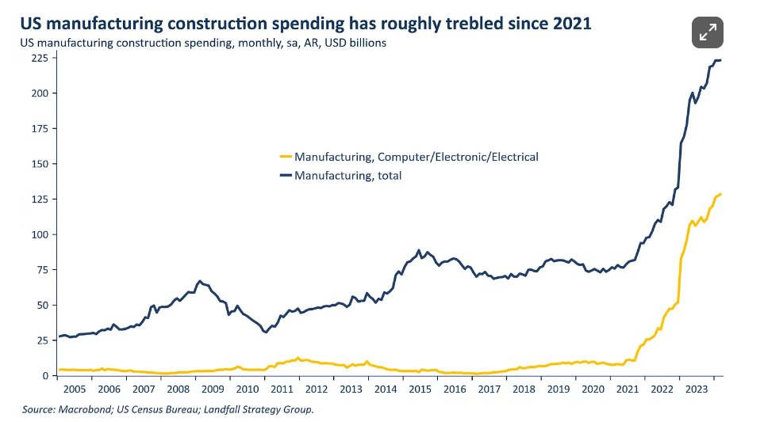
Reshoring and Robotics
The U.S. is pursuing an industrial policy to rebuild its industrial base.
But this will only be cost-effective with robotics.

Slide 23
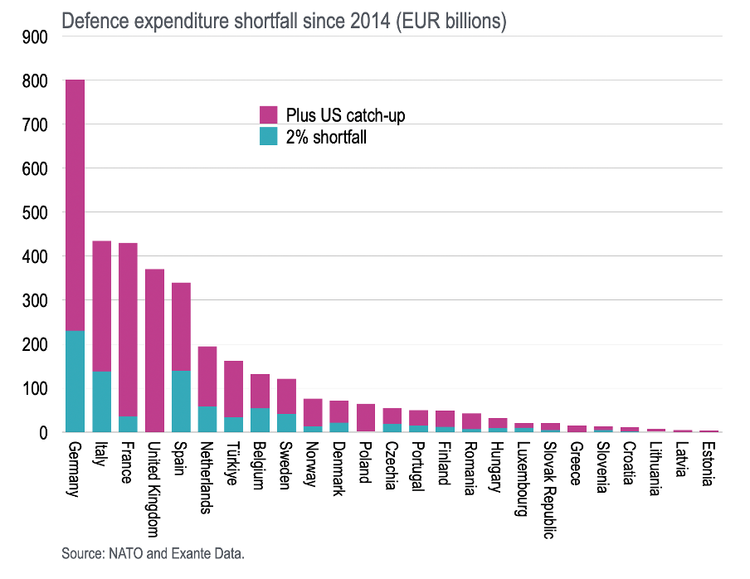

Europe €850bn defence shortfall
Europe’s Cumulative Underspend:
Since 2014, European NATO members have underspent by €850bn relative to the agreed 2% of GDP target.
Bridging the US Gap:
Had Europe aimed to match the U.S. level of ~3.5% of GDP, Germany’s shortfall would exceed €800bn.
Across the continent, the cumulative defence funding gap totals over €2.65tn - huge underinvestment.

Slide 24
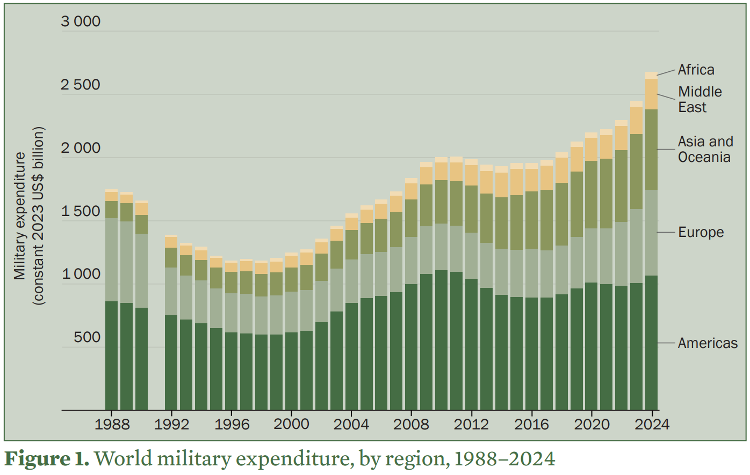
Record surge in defence spending
Global military spending rose 9.4% in 2024 – the steepest increase since 1988.
European defence spending jumped 17% in 2024, to $693 billion – up 83% since 2015.
East Asia saw a 7.8% rise - the biggest annual increase since 2009.
Japan hiked its defence budget by 21% – the largest jump since 1952. China’s budget up 7%.
Source: https://www.sipri.org/sites/default/files/2025-04/2504_fs_milex_2024.pdf
Notes:
Israeli figures

Slide 25
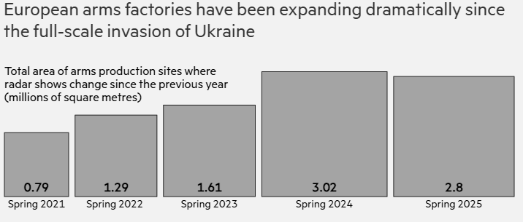
Europe’s arms factories growing 3x faster than pre-war
FT tracked changes at sites associated with ammunition and missile production.
Areas marked by changes jumped from 790,000 sq metres in 2020-21 to 2.8mn sq metres in 2024-25, the analysis showed.
European 155mm artillery shell production: 300,000 rounds/year pre-war → potentially 2 million/year by end-2025
Source: FT analysis, European Space Agency data https://www.ft.com/content/ce617187-43ed-4bec-aebf-b1b346c4cfb1?shareType=nongift
Notes:
Bottle neck

Slide 26
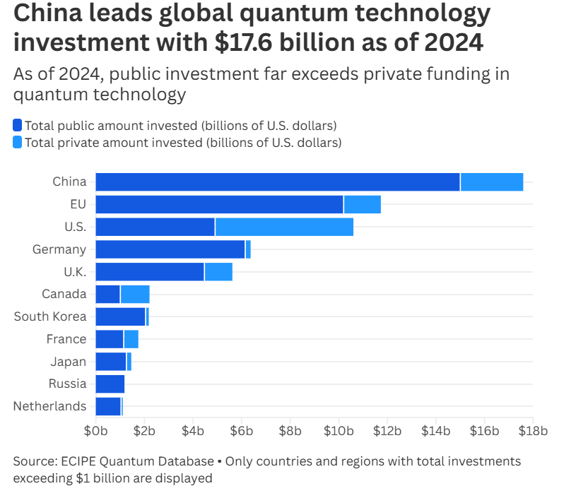
Quantum – surging investments

Slide 27
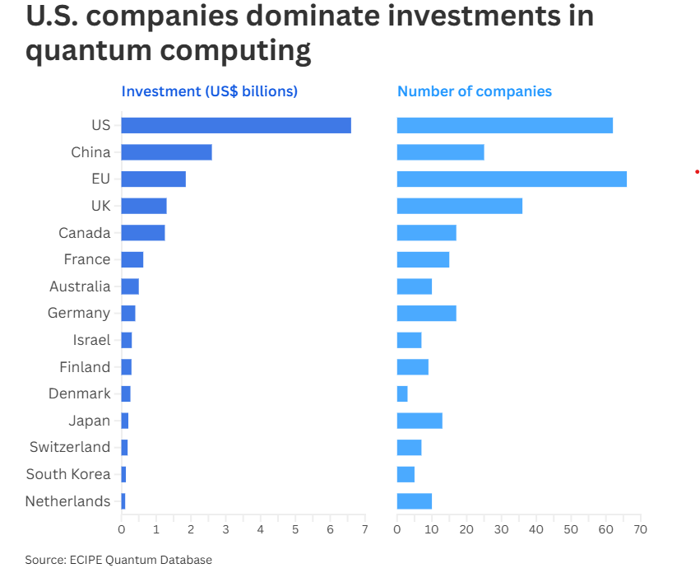
Quantum – surging investments

Slide 28
Diversified Tech Investing
Global Mix – reduces volatility.
Broad Index - Equal Weight (140).
Tailwinds – lower rates, AI Convergence
Subscription Revenues (Netflix, Cloud)

