Slide 1
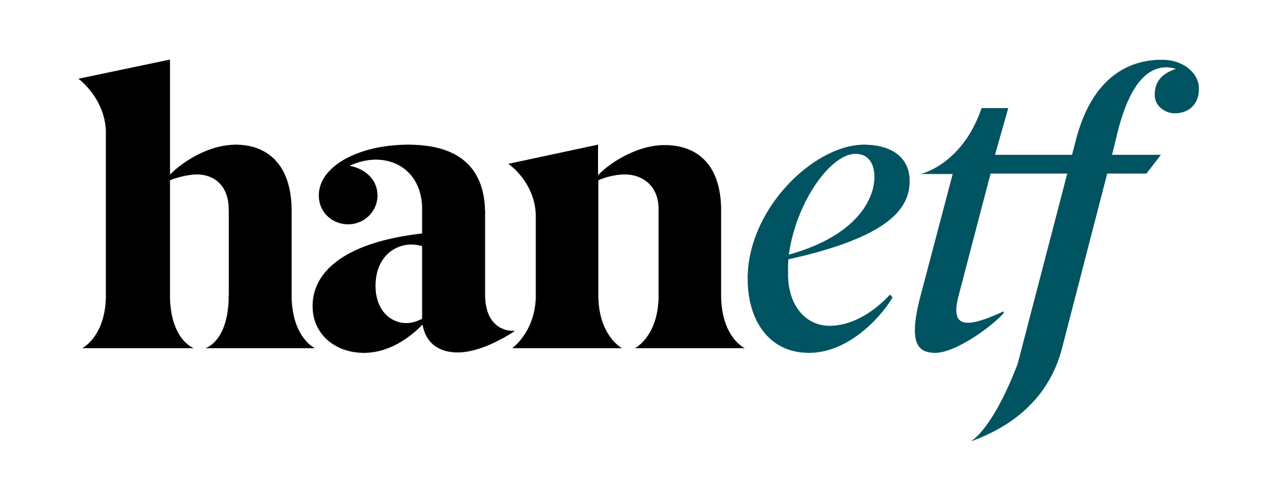

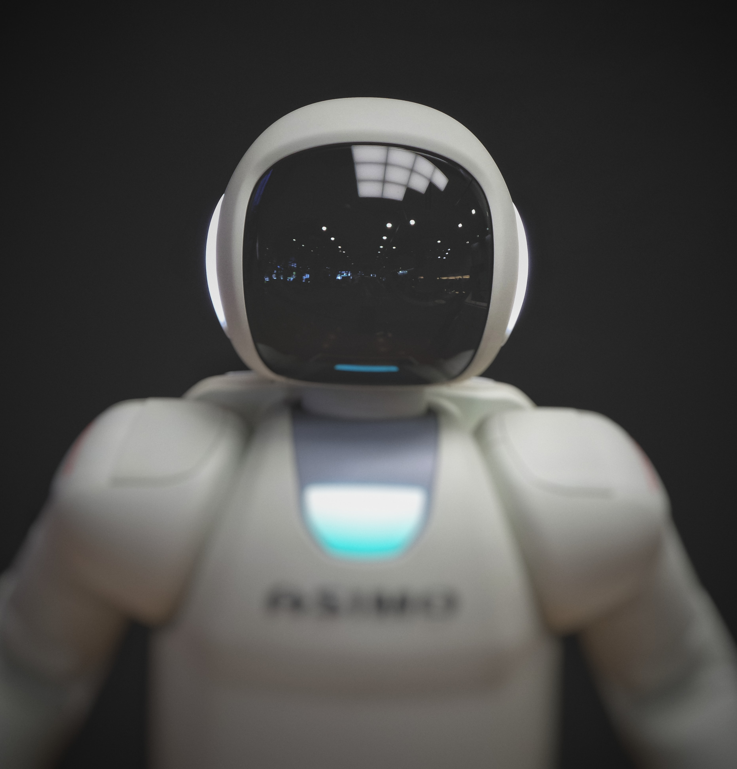
Tech Megatrends
HAN-GINS Tech Megatrend UCITS ETF
For professional clients only. Capital at risk
The content of this document does not constitute investment advice nor an offer for sale nor a solicitation to buy any product or make an investment.

Slide 2
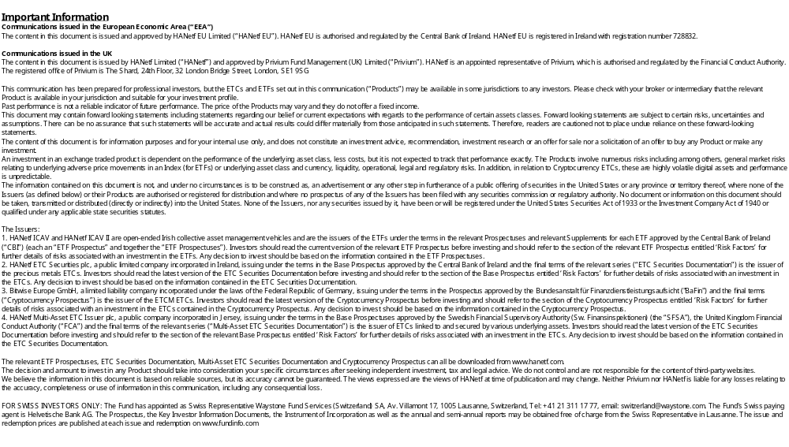

Slide 3



Industrial Revolution 4.0
Tech Megatrends (140 stocks)
Future Transport
Digital Entertainment
Social Media
Cyber Security
MEGATRENDS
10 Themes
AI & Robotics
Quantum Computing
Defence Technology
Cloud Computing
Blockchain
Genomics
www.HANetf.com
info@hanetf.com

Slide 4
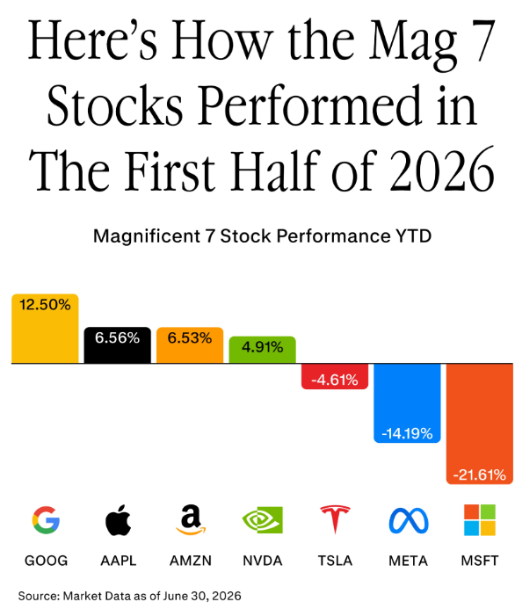
Source: GinsGlobal, Morningstar (1 July 2026). For illustrative purposes only. All performance figures showing net data. Past performance is not indicative of future performance. You cannot invest directly in an index.

Slide 5
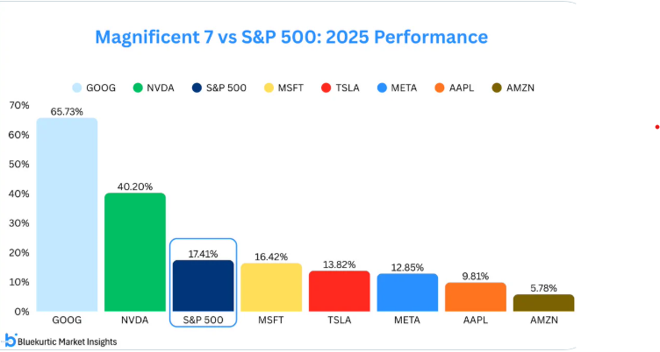
Mag 7 vs S&P 500 (in 2025)
Source: GinsGlobal; Bloomberg. Data from Jan 2025 – Dec 2025. For illustrative purposes only. All performance figures showing net data. Past performance is not indicative of future performance. You cannot invest directly in an index.

Slide 6
Tech Megatrends
Source: HANetf; Bloomberg. Data from Jan 2023 – Dec 2025. For illustrative purposes only. All performance figures showing net data. Past performance is not indicative of future performance. You cannot invest directly in an index.

Slide 7
US Resilient: Soft-Landing
Low unemployment & interest rates
Healthy US GDP growth of 3%+ (Q2 and Q3 2025)
Inflation <3% (June 2026)
Potential positive earnings: analysts expect 14% S&P 500 EPS gains this year (FactSet, 2026)
We’re seeing less red-tape and lower taxes
Source: GinsGlobal; Federal Reserve; Bureau of Economic Analysis; Factset, Trading Economics. Estimated earnings growth is no guarantee of actual earnings growth. Views presented are those of GinsGlobal Index Funds.

Slide 8
TER | 49 bps
Future of Defence UCITS ETF
NATO
Positive Tech Outlook 2026
Tech M&A - activity rebounding (McKinsey)
Outsourcing – AI, Cloud & Cybersecurity
Robotics – Onshoring / potential tariff benefits
Strong 2026 Earnings & Convergence
Weaker US$ – boosts US Tech earnings
Source: GinsGlobal; McKinsey; Federal Reserve, Reuters, U.S. Bank, as of 06.02.2026. Views presented are those of GinsGlobal Index Funds.

Slide 9
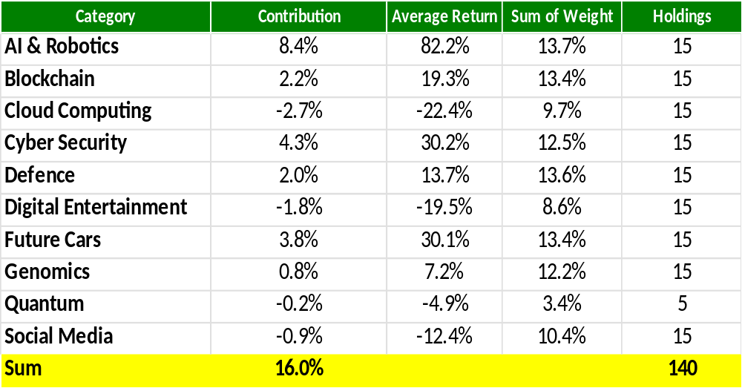
Tech Megatrend Index: 2026 YTD returns
Source: GinsGlobal; Solactive. Data as of 30.06.2026. Past performance is not indicative of future performance.

Slide 10
Diversified Tech Investing
Global Mix – reduces volatility.
Broad Index – Equal Weight (140).
Top 10 <12% weighting
Tailwinds – Fiscal Stimulus, AI Infrastructure
Subscription Revenues; Convergence – AI, Cloud, Cybers
Source: GinsGlobal.

Slide 11
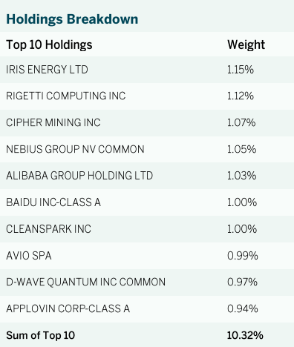
MEGATREND FUND – Weights
Mag7 Holdings | Nasdaq Weight | Fund Weight
MICROSOFT CORP | 8.8% | 0.9%
APPLE INC | 7.4% | 0.8%
NVIDIA CORP | 6.3% | 0.9%
AMAZON.COM INC | 5.3% | 0.0%
META PLATFORMS INC | 4.8% | 0.9%
ALPHABET INC-CL A | 2.5% | 1.0%
ALPHABET INC C-SHARES | 2.4% | 0.0%
TESLA INC | 2.4% | 0.7%
TOTAL | 39.9% | 5.2%
Source: GinsGlobal; HANetf; Bloomberg; Nasdaq. Nasdaq 100 weights as of 30.07.2025, ITEK weights as of 30.09.2025.

Slide 12
TER | 49 bps
Future of Defence UCITS ETF
NATO
Theme & production selection over time is difficult
Themes sorted by Sharpe Ration (1 = highest)
Rank | 2018 | 2019 | 2020 | 2021 | 2022 | 2023 | 2024 | 2025 | 2026 YTD
1 | Cloud & Digital 1 | Digital Entertainment | Blockchain | Quantum 1 | Defence 2 | Quantum 2 | Digital Entertainment | Cars & Battery 1 | Robotics 1
2 | Cyber Security 2 | Robotics 2 | Digital Entertainment | Defence 1 | Defence 1 | Defence 1 | Defence 1 | Defence 2 | Defence 2
3 | Cyber Security 1 | Blockchain | Cars & Battery 1 | Robotics 2 | Health & Biotech 2 | Robotics 2 | Quantum 2 | Defence 1 | Cars & Battery 2
4 | Defence 1 | Quantum 1 | Cloud & Digital 1 | Cyber Security 1 | Cars & Battery 1 | Blockchain | Quantum 1 | Health & Biotech 2 | Cars & Battery 1
5 | Health & Biotech 1 | Defence 1 | Cars & Battery 2 | Robotics 1 | Cyber Security 1 | Cyber Security 1 | Cloud & Digital 2 | Quantum 2 | Defence 1
6 | Health & Biotech 2 | Cloud & Digital 2 | Health & Biotech 1 | Cars & Battery 1 | Health & Biotech 1 | Quantum 1 | Defence 2 | Cars & Battery 2 | Robotics 2
7 | Cloud & Digital 2 | Defence 2 | Robotics 1 | Blockchain | Cloud & Digital 1 | Cyber Security 2 | Cyber Security 1 | Digital Entertainment | Health & Biotech 1
8 | Defence 2 | Robotics 1 | Cyber Security 1 | Cars & Battery 2 | Cyber Security 2 | Digital Entertainment | Cyber Security 2 | Blockchain | Health & Biotech 2
9 | Digital Entertainment | Cyber Security 2 | Cloud & Digital 2 | Defence 2 | Quantum 2 | Cloud & Digital 2 | Blockchain | Health & Biotech 1 | Quantum 1
10 | Robotics 2 | Cars & Battery 2 | Robotics 2 | Cyber Security 2 | Cars & Battery 2 | Robotics 1 | Robotics 2 | Robotics 1 | Blockchain
11 | Robotics 1 | Cyber Security 1 | Cyber Security 2 | Cloud & Digital 2 | Digital Entertainment | Cloud & Digital 1 | Cloud & Digital 1 | Quantum 1 | Quantum 2
12 | Blockchain | Cloud & Digital 1 | Health & Biotech 2 | Digital Entertainment | Cloud & Digital 2 | Defence 2 | Health & Biotech 1 | Robotics 2 | Cyber Security 2
13 | Cars & Battery 2 | Cars & Battery 1 | Quantum 1 | Cloud & Digital 1 | Robotics 2 | Cars & Battery 2 | Robotics 1 | Cyber Security 1 | Digital Entertainment
14 | Cars & Battery 1 | Health & Biotech 1 | Defence 1 | Health & Biotech 2 | Quantum 1 | Cars & Battery 1 | Cars & Battery 1 | Cyber Security 2 | Cyber Security 1
15 |  | Health & Biotech 2 | Defence 2 | Health & Biotech 1 | Robotics 1 | Health & Biotech 1 | Cars & Battery 2 | Cloud & Digital 2 | Cloud & Digital 2
16 |  |  |  |  | Blockchain | Health & Biotech 2 | Health & Biotech 2 | Cloud & Digital 1 | Cloud & Digital 1
*Sorted by Sharpe Ratio. Source: Bloomberg, data as of February 2026. For illustrative purposes only.
www.HANetf.com
info@hanetf.com

Slide 13
Global Tech Mix – 140 stocks
USA 56%, China 12%, Japan 8%, Israel 3.5%, Germany 3%.
Category | 2025 return
AI & Robotics | 11.49%
Blockchain | 32.19%
Cloud Computing | 9.63%
Cyber Security | 14.14%
Defense Technology | 0.13%
Digital Entertainment | 8.49%
Future Cars | 5.53%
Genomics | 9.14%
Quantum Computing | -25.82%
Social Media | 7.34%
Source: GinsGlobal; Solactive. Data as of 31.12.2025. Past performance is not indicative of future performance.

Slide 14
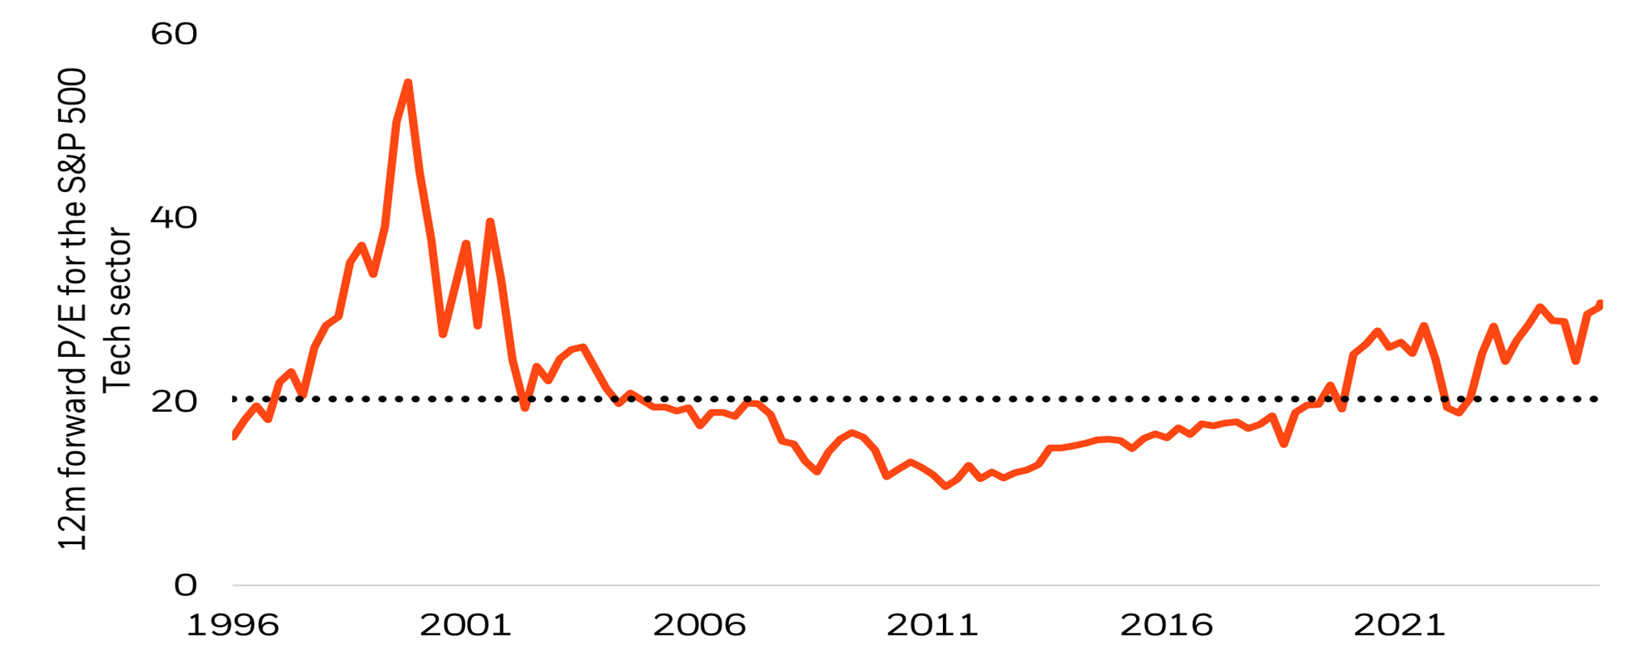
US Tech: P/E ratio – S&P 500 IT Index
Source: Bloomberg as of Sept 2025. P/E ratio as measured by the 12-month forward P/E ratio. ‘Price/Equity’ ratio is the price of the stock divided by the company’s earnings per share, aggregated to the index level. For illustrative purposes only.

Slide 15
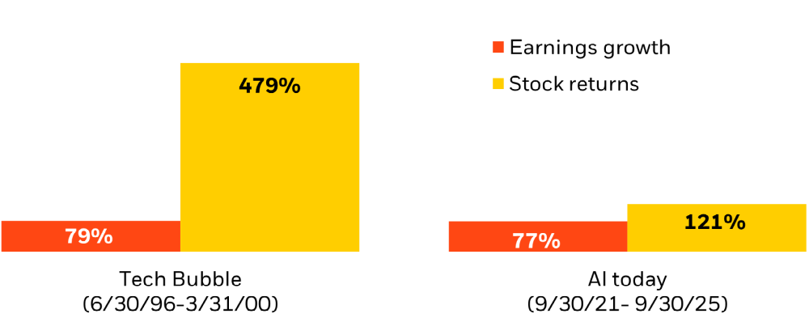
US Tech Earnings: Comparison
Source: Refinitiv from 6/30/1996 to 3/31/2000, and AI today 9/30/2021 to 9/30/2025 (right). Price represented by the S&P 500 Information Technology Index, and Earnings represented by the I/B/E/S S&P 500 Information For illustrative purposes only.

Slide 16
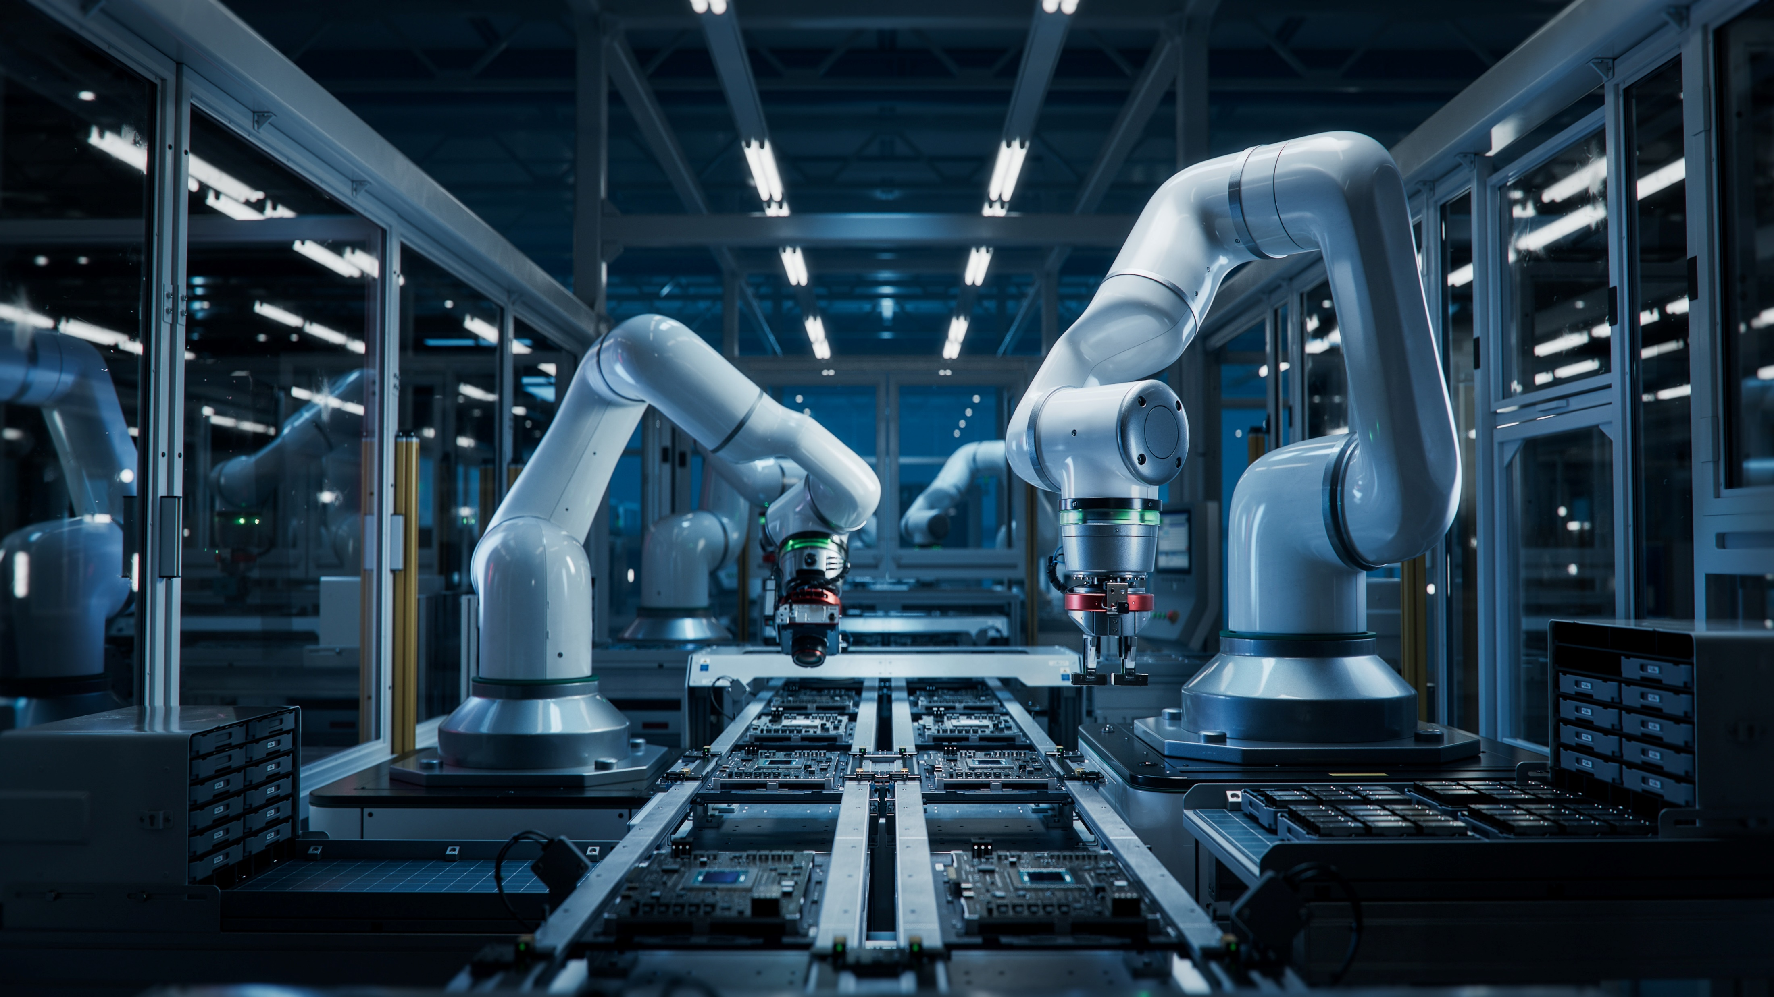
Tech Megatrend – Valuations
Nasdaq P/E 32X vs Megatrends 20X
  P/Book 7.1 vs 2.9.
  P/Sales 5.1 vs 2.6.
MegaCap weight: 58% Nasdaq vs 9%.
Top 10 Holdings: 49% Nasdaq vs 10%.
Top 5 Holdings: 35% Nasdaq vs 6%.
Source: Gins Global. Data as of Jan 2026. For illustrative purposes only.

Slide 17

Tech Megatrends Outlook
Converging – AI, cloud, social media, gaming, quantum.
AI $3tn spend expected within 5yrs (FT, Gartner).
Strong Balance Sheets – not 1999.
Onshoring tailwinds.
Source: Gins Global, Goldman Sachs.

Slide 18
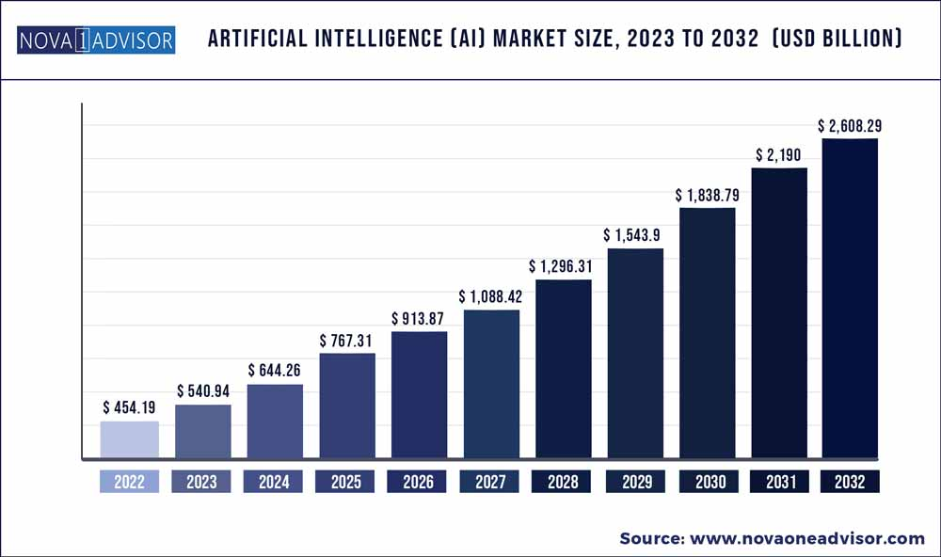
AI Market Forecast
Source: Nova one Advisor, 2026. For illustrative purposes only. Chart displays expected data.
Notes:
Additional reading: savvyreport_nyli_june2024_ver3_final2.pdf (savvyinvestor.net)

Slide 19
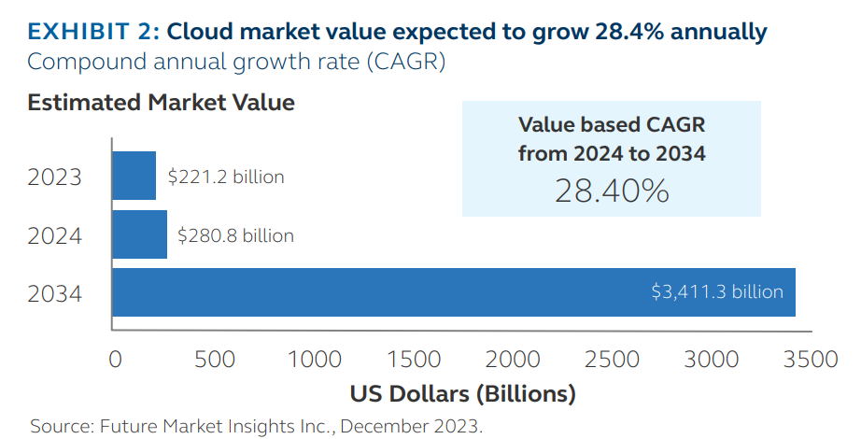
Cloud Market Growth
Source: Future Market Insights Inc, December 2023. For illustrative purposes only. Chart displays expected data.
Notes:
10 trends driving the global data center market (irei.com)

Slide 20
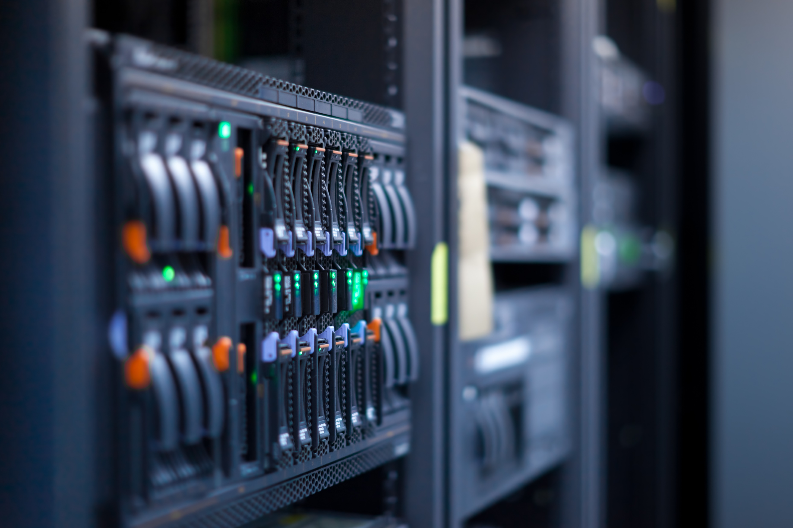
AI & Cloud Booming
AI boosting cloud spend.
Cloud expected to be 50% of Corporate IT spend by 2026 (S&P Global, Gartner).
Cloud < 25% corporate workloads.
Projected 20%+ CAGR from 2025 to 2030 (Grand View Research).
WFH/Hybrid → Cloud cost savings.
Source: GinsGlobal. Views presented are those of GinsGlobal Index Funds.

Slide 21
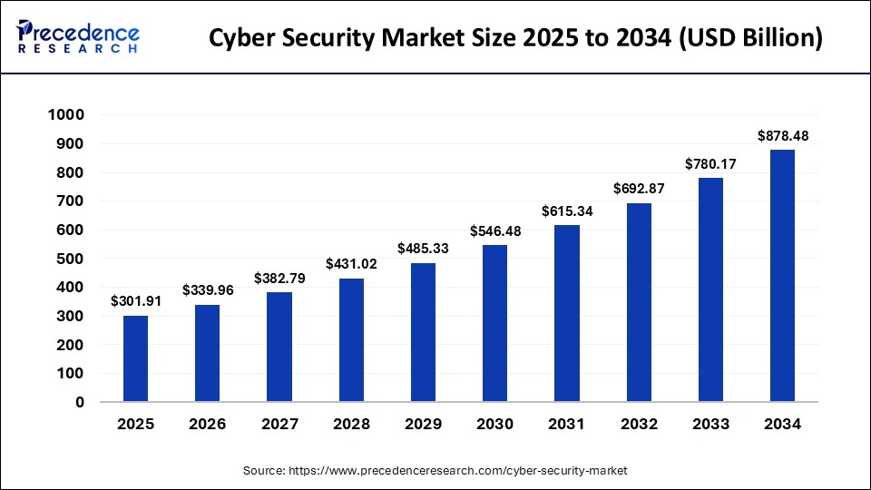
Cybersecurity market expected to double
Source: Precedence Research, 2025. For illustrative purposes only. Chart displays expected data.

Slide 22
Quantum – surging investments
Tech breakthroughs accelerating.
  Milestones (Google’s Willow & IBM).
  IonQ’s scaling toward millions of qubits.
US and UK Tech Prosperity Deal: $42bn+ for quantum computing, AI, nuclear. Viable commercial uses (Reuters).
Cloud-based quantum platforms – strategic partnerships
Revolutionary leap in computational power.
Key sectors – Pharma, AI, finance, materials science, logistics.
Source: GinsGlobal. Views presented are those of GinsGlobal Index Funds.

Slide 23
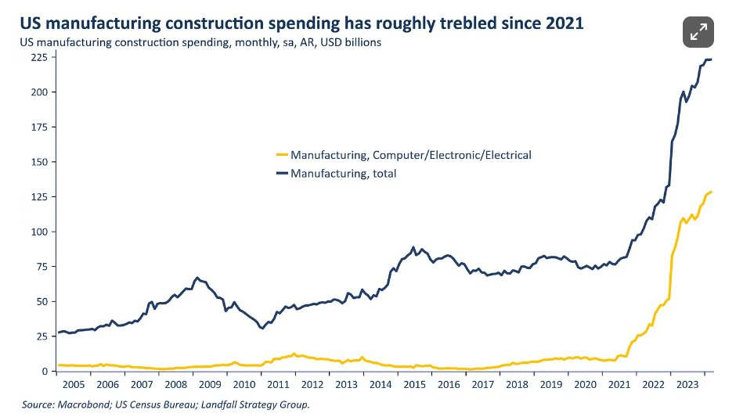
Reshoring and Robotics
The U.S. is pursuing an industrial policy to rebuild its industrial base.
But this will only be cost-effective with robotics.
Source: Federal Reserve Bank. Data as of 23.02.2024. Chart is in billions of dollars. For illustrative purposes only.

Slide 24
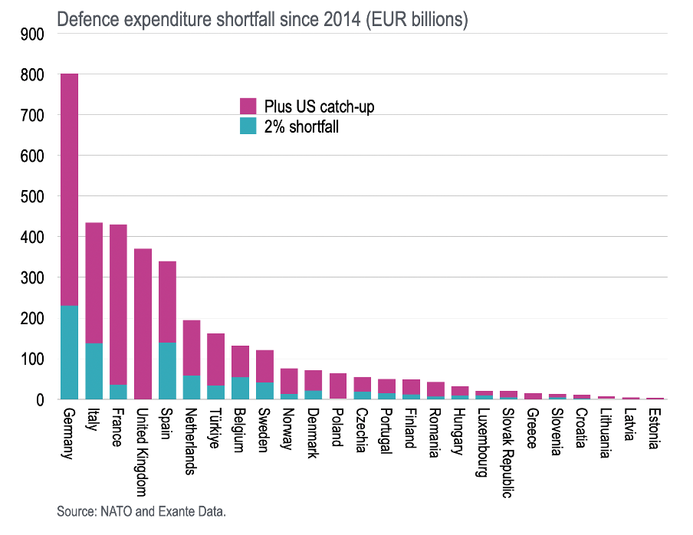

Europe €850bn defence shortfall
Europe’s Cumulative Underspend:
Since 2014, European NATO members have underspent by €850bn relative to the agreed 2% of GDP target.
Bridging the US Gap:
Had Europe aimed to match the U.S. level of ~3.5% of GDP, Germany’s shortfall would exceed €800bn.
Across the continent, the cumulative defence funding gap totals over €2.65tn - huge underinvestment.
Source: NATO; Exante Data. Data as of 2025. For illustrative purposes only.

Slide 25
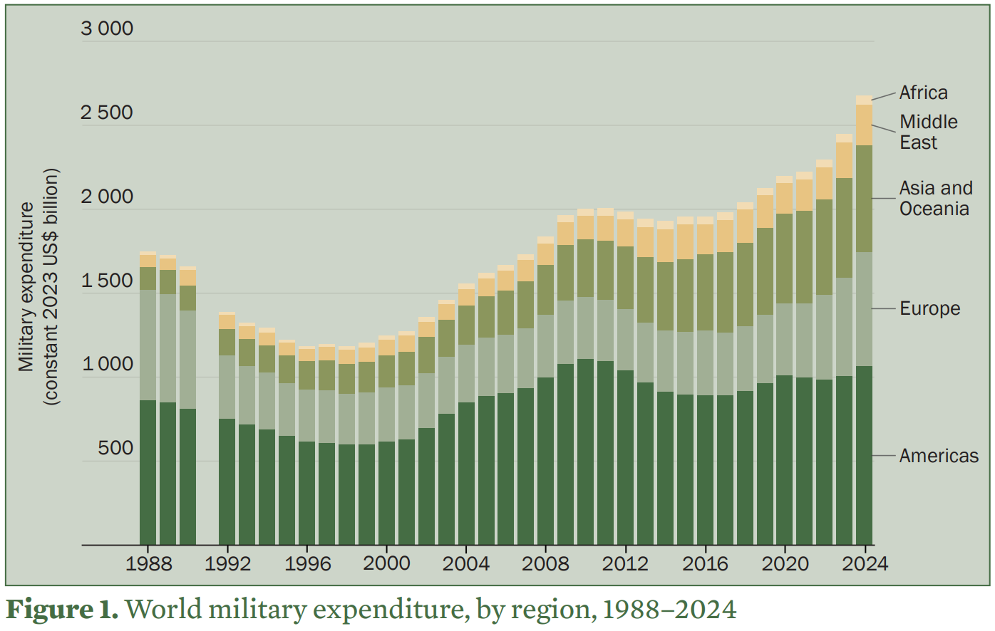
Record surge in defence spending
Global military spending rose 9.4% in 2024 – the steepest increase since 1988.
European defence spending jumped 17% in 2024, to $693 billion – up 83% since 2015.
East Asia saw a 7.8% rise - the biggest annual increase since 2009.
Japan hiked its defence budget by 21% – the largest jump since 1952. China’s budget up 7%.
Source: SIPRI, April 2025. For illustrative purposes only.
Notes:
Israeli figures

Slide 26
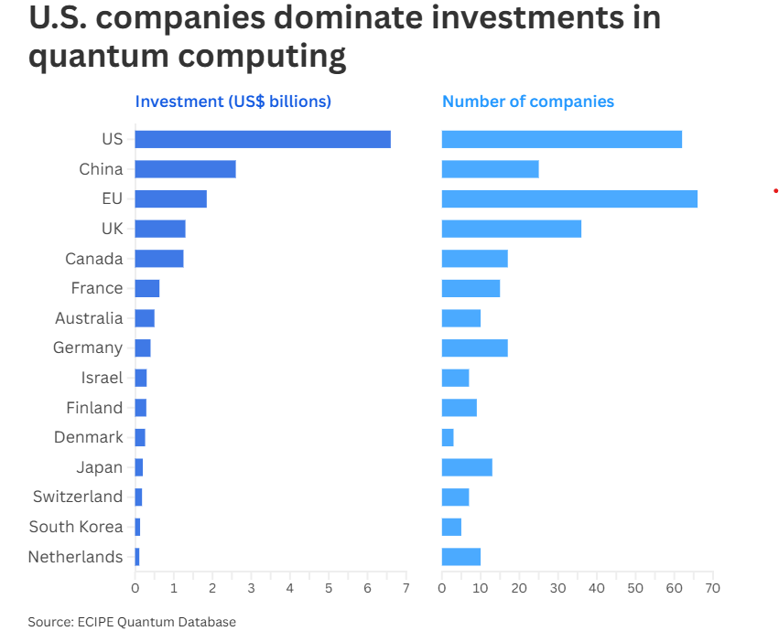
Quantum – surging investments
Source: CNBC, ECIPE Quantum Database, 2026. For illustrative purposes only.

Slide 27
Diversified Tech Investing
Global Mix – reduces volatility
Broad Index – equal weight (140)
Potential tailwinds – lower rates, AI convergence
Subscription revenues (Netflix, Cloud)
Source: GinsGlobal. Views presented are those of GinsGlobal Index Funds.

Slide 28
Key risks
Information technology companies are generally subject to the following risks: rapid technological changes; short product lifecycles; increase competition; more aggressive pricing and reduced profit margins; loss of patents, copyrights and trademark protections; cyclical market patterns; evolving industry standards; and frequent new product innovations.
Thematic ETFs are exposed to a limited number of sectors and thus the investment will be concentrated and may experience high volatility.
Investors’ capital is fully at risk and may not get back the amount originally invested.
Exchange rates can have a positive or negative effect on returns.
Past performance is not indicative of future performance.
This is not an exhaustive list, further risks can be found in the Prospectus.

